Slide 1
KEYLOGGER AND SECURITY
CAPSTONE PROJECT
Presented By:
A.Pragalanathan
J.K.K.Nataraja College Of Engineering And Technology
B.Tech-Information Technology

Slide 2
OUTLINE
Problem Statement
Proposed System/Solution
System Development Approach
Algorithm & Deployment
Result (Output Image)
Conclusion
Future Scope
References

Slide 3
Problem Statement
In today's digital age, where cybersecurity threats loom large, one of the significant concerns is the proliferation of keyloggers, stealthy software tools designed to monitor and record keystrokes on a user's computer without their knowledge. Keyloggers pose a severe threat to individuals and organizations as they can capture sensitive information such as passwords, credit card details, and other personal data, leading to identity theft, financial loss, and privacy breaches.

Slide 4
Proposed Solution
To protect yourself or your organization from keyloggers and enhance cybersecurity, here are some solutions and best practices you can follow:
Use Antivirus and Anti-malware Software: Install reputable antivirus and anti-malware software on your computer systems and keep them up to date. These tools can detect and remove keyloggers and other malicious software.
Regularly Update Operating Systems and Applications: Keep your operating systems, software applications, and web browsers updated with the latest security patches and bug fixes. Updates often include security enhancements that can help protect against known vulnerabilities exploited by keyloggers.

Slide 5
Proposed Solution
Exercise Caution with Email Attachments and Downloads: Be cautious when opening email attachments or downloading files from the internet, especially if they are from unknown or suspicious sources. Keyloggers can be disguised as legitimate files, so carefully scan them with antivirus software before opening or executing.
Enable Firewall Protection: Activate and configure a firewall on your computer systems to monitor and control incoming and outgoing network traffic. Firewalls can help prevent unauthorized access and block malicious activity, including attempts by keyloggers to communicate with external servers.
Be Wary of Phishing Attacks: Keyloggers are often distributed through phishing emails or fake websites that trick users into revealing sensitive information. Be vigilant and avoid clicking on suspicious links or providing personal information unless you are certain of the source's legitimacy.

Slide 6
Proposed Solution
Use Two-Factor Authentication (2FA): Enable two-factor authentication wherever possible, especially for critical accounts such as email, banking, and social media. 2FA adds an extra layer of security by requiring a second verification step, typically a unique code sent to your mobile device, in addition to your password.
Employ Virtual Keyboards: When entering sensitive information like passwords, consider using an on-screen virtual keyboard instead of a physical keyboard. Virtual keyboards help bypass hardware keyloggers that capture keystrokes directly from physical keyboards.
Regularly Monitor Account Activity: Keep a close eye on your financial accounts, credit reports, and other online accounts for any unusual activity. Promptly report any suspicious transactions or signs of unauthorized access to the respective service providers..

Slide 7
Proposed Solution
Educate and Train Employees: Organizations should conduct regular cybersecurity awareness training for employees to educate them about keyloggers, phishing attacks, and other security threats. Teach employees to recognize and report suspicious activities and emphasize the importance of following security protocols.
Secure Remote Access: If you work remotely or manage remote teams, ensure that remote access to your systems is secured using strong encryption, virtual private networks (VPNs), and multi-factor authentication.

Slide 8
System Approach
The "System Approach" section outlines the overall strategy and methodology for developing and implementing the rental bike prediction system. Here's a suggested structure for this section:
Incident Response Plan
Employee Awareness and Training
Data Encryption
Regular Security Audits
Continuous Monitoring and Improvement

Slide 9
Algorithm & Deployment
Algorithm:
Install and update antivirus and anti-malware software: This involves selecting a reputable antivirus and anti-malware solution and installing it on all computer systems. Regular updates are crucial to ensure that the software can detect and prevent the latest keyloggers and malware threats.
Regularly update the operating system and software: Keeping the operating system, web browsers, and other software applications up to date is essential to address known vulnerabilities that keyloggers can exploit. Software updates often include security patches that help protect against keylogger attacks.
Be cautious of phishing attempts: Phishing emails and malicious links are common delivery methods for keyloggers. It's important to educate users about the signs of phishing attempts and provide guidance on how to avoid falling victim to them. Caution should be exercised when clicking on links or downloading attachments from unknown or suspicious sources.
Enable two-factor authentication (2FA): Implementing 2FA adds an extra layer of security by requiring users to provide an additional verification factor, such as a temporary code sent to their smartphone, in addition to their password. This helps protect against keyloggers that may capture passwords but cannot capture the second factor.
Use a virtual private network (VPN): A VPN encrypts internet traffic, making it more difficult for keyloggers to intercept sensitive information. Deploying VPN solutions, especially when accessing the internet through public Wi-Fi networks, can help protect against keylogger attacks.

Slide 10
Algorithm & Deployment
Deployment Process:
Identify the keylogger threat: Recognize the severity of keyloggers as a threat to individuals and organizations. Understand the potential risks and consequences associated with keyloggers to prioritize implementing appropriate security measures.
Conduct a risk assessment: Evaluate the existing infrastructure, systems, and processes to identify vulnerabilities that could be exploited by keyloggers. Assess the potential impact of a keylogger attack on sensitive information, financial loss, and privacy breaches.
Develop a strategy and plan: Based on the risk assessment findings, develop a comprehensive strategy and plan to mitigate the risks associated with keyloggers. This may include a combination of technical solutions, user awareness training, and policy changes.
Procure and install security software: Select and procure antivirus and anti-malware software from reputable vendors. Install the software on all computer systems within the organization, ensuring coverage for both individual workstations and network servers.
Establish procedures for regular updates: Create a process for regularly updating the antivirus and anti-malware software, operating systems, web browsers, and other software applications. This may involve setting up automated updates or assigning responsibility to IT staff for carrying out the updates.

Slide 11
Algorithm & Deployment
Conduct user awareness training: Educate employees about keyloggers, their risks, and safe online practices. Provide guidance on recognizing phishing attempts, using strong passwords, and avoiding suspicious downloads. Encourage reporting of any potential keylogger incidents.
Implement two-factor authentication and VPN solutions: Enable and configure two-factor authentication for relevant systems and applications. Deploy and configure VPN solutions to ensure secure internet connections, especially when accessing sensitive information or using public Wi-Fi networks.
Establish monitoring and incident response procedures: Implement a centralized logging and monitoring system to detect and respond to potential keylogger incidents. Establish incident response procedures, including isolating affected systems, conducting forensics analysis, and notifying appropriate personnel.
Regularly review and update security measures: Stay updated on evolving cybersecurity threats and best practices. Conduct periodic audits and assessments to evaluate the effectiveness of the implemented security measures and make improvements as necessary.
Promote a culture of cybersecurity awareness: Foster a culture of cybersecurity within the organization by encouraging ongoing learning and awareness. This can include regular communication, training sessions, and reminders about the importance of following security practices.

Slide 12
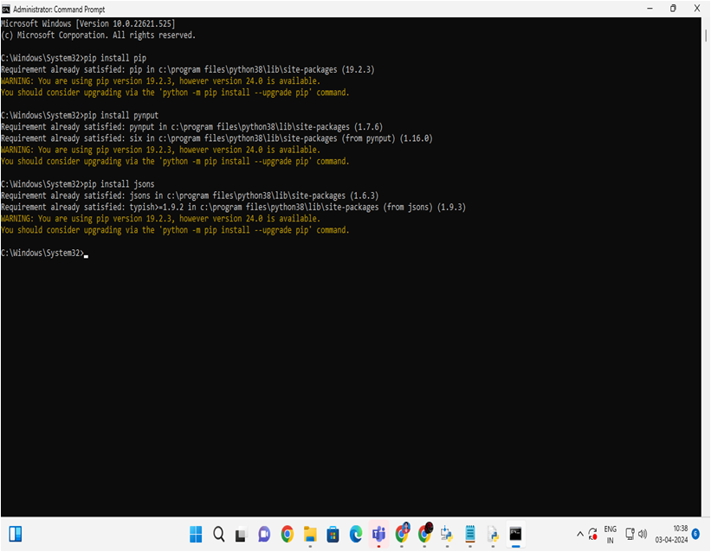

PROGRAM AND DEPLOY

Slide 13


RESULT

Slide 14
Result
Implementing robust antivirus and anti-malware software, regular software updates, user awareness training, two-factor authentication, VPN usage, and centralized monitoring can greatly reduce the risk of keyloggers and enhance overall cybersecurity.

Slide 15
Conclusion
In conclusion, by implementing a comprehensive system approach that includes robust antivirus measures, user awareness training, strong authentication methods, and proactive monitoring, the risk of keyloggers can be significantly mitigated, enhancing overall cybersecurity.

Slide 16
Future scope
Continued advancements in machine learning and behavior-based detection techniques can help improve the detection and prevention of keyloggers, while increased adoption of encryption technologies and secure hardware solutions may further mitigate the risk of keystroke capture

Slide 17
References
Implementing comprehensive anti-keylogging software and regularly updating security protocols can mitigate the threat of keyloggers effectively. Additionally, promoting user education and awareness about safe online practices can further enhance cybersecurity resilience.

Slide 18
THANK YOU

